Slide 1






Austin Code Camp 2012
Sponsors

Slide 2
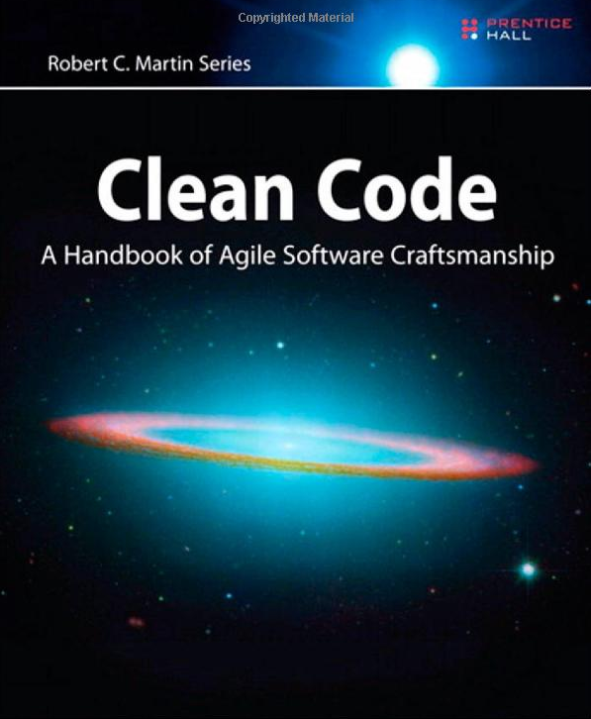
Clean Code Intro
Presented By:
Fernando Zamora
Twitter: @fernandozamoraj
Blog: fernandozamorajimenez.blogspot.com
Github: https://github.com/fernandozamoraj

Slide 3
About Me
Fernando Zamora
Developer
Aspiring Craftsman
Work: Technical Lead MAT, Government Contract Winforms C#
Hobbies: Write code outside of work that I don’t get to write at work
Games: XNA, Windows Phone, Android
Web: HTML5, PHP, Asp.net, Javascript, PHP

Slide 4
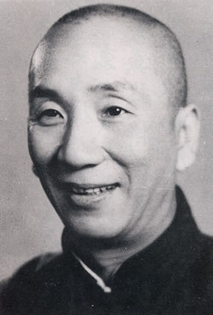
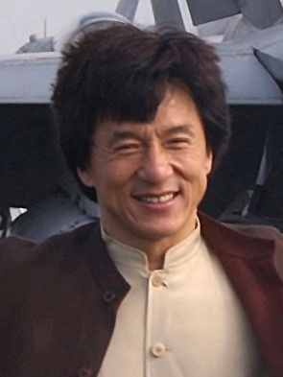
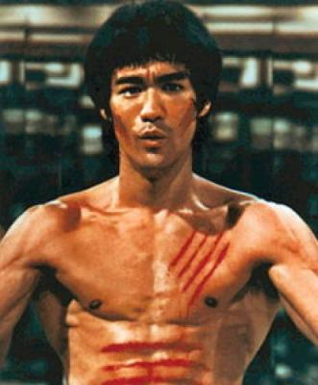
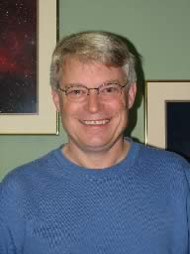

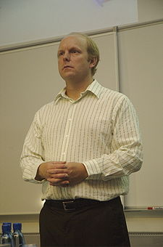
Philosophy – Clean Code
Just like martial arts has many masters with different styles, so does Clean Code **
Jeet Kune Do
Drunken Master?
Wing Chun
Code Complete
S.O.L.I.D
TDD

Slide 5
Philosophy
Principles and techniques
Boy scout Principle
Always clean as you go
In line with:
REFACTOR
S.O.L.I.D
DRY
TDD
Boy Scout

Slide 6
Why is Clean Code Important
Fast productivity (during maintenance)
Technical Debt (It is costly to own a mess)
Productivity decreases asymptotically eventually down to 0
Boy Scout Rule: Leave the code better than you found it
Happier Developers: As the old saying goes:"Write your code as if the person that's going to maintain it is a psychotic serial killer who knows where you live.“
Writing Code is What We Do

Slide 7
Clean Code
Testable
EXPRESSIVE
efficient
maintainable
EXPECTED
readable
Elegant
SELF DOCUMENTING
simple

Slide 8
Bad Code
Superlong Methods
Mixed Levels of Abstraction
bad comments
Too many args
Bad var/func names
output args
Flag args
Unpronounceable Variables
Subtle name variations

Slide 9
Choosing Names
Meaningful names
Avoid small variations in names – s1, s2
4. Meaningful Distinctions
if (!fundsAvailable || availableFunds < -0.004m)
5. Pronounceable Names – (avoid abbreviations e.g. rptparam)
Searchable Names – MAX_DAYS instead of 999
Function Names are verbs
9. Data fields and Classes are nouns

Slide 10
Choosing Names
Interfaces and implementations – IShapeFactory, ShapeFactory
Avoid mental mapping – i, a, b, c
With overloaded constructors use static factory methods instead
Don’t be cute – e.g. EatMyShorts instead of Abort
One word per concept – get, fetch, retrieve
Use solution domain names – JobsQueue
Use problem domain names – PartRequestService
Method names should describe everything they do in their name
Hint: If your method name is too long than your method may be doing to much

Slide 11
Functions Rules
Small
Smaller
Do one thing
Do it well
Do it only
One level of abstraction
Read from the top down like a set of To paragraphs

Slide 12
Many Levels of Abstraction Example
public void PrintReports()
{
List<DataElement> reports = new List<DataElement>();
foreach (var rawElement in _someRepo.GetReportElements())
{
var formattedElement = _formatter.Format(rawElement);
reports.Add(_formatter.Format(rawElement));
}
PrintReports(reports);
PrintSummaryReport(reports);
}

Slide 13
One Level of Abstraction Example
public void PrintReports()
{
List<DataElement> reports = GetReports();
PrintReports(reports);
PrintSummaryReport(reports);
}

Slide 14
Exercise Part 1 – Fix This Code
public bool ValidLogin(string userNme, string pwd, out string msg)
{
bool rslt = false;
User usr = _repository.GetUser(userNme);
msg = string.Empty;
if(usr != null){
if(_passwdHashSvc.HashMatches(usr.PwdHash, pwd)){
rslt = true;
}
else{
msg = "Invalid user or password";
}
}
else{
msg = "Invalid user or password";
rslt = false;
}
if(!string.IsNullOrEmpty(msg))
MessageBox.Show(msg);
return rslt;
}

Slide 15
Exercise Part 1 – Abstraction Level Fix
public bool ValidLogin(string userNme, string pwd, out string msg)
{
msg = string.Empty;
bool rslt = false;
User usr = _repository.GetUser(userNme);
if(HashMatches(usr.PwdHash, pwd))
{
rslt = true;
}
else{
msg = "Invalid user or password";
rslt = false;
}
DisplayMsg(msg);
return rslt;
}

Slide 16
Exercise Part 2 – Name Fix
public bool IsValidLoginOrDisplayMessage(string userName, string password, out string message)
{
message = string.Empty;
bool result = false;
User user = _repository.GetUser(userName);
if(user != null && HashMatches(user.PasswordHash, password))
{
result = true;
}
else{
message = "Invalid user or password";
result = false;
}
DisplayMessage(message);
return result;
}

Slide 17
Exercise Part 3 – Second Cycle
public bool IsValidLogin(string userName, string password)
{
User user = _userRepository.GetUser(userName);
return _hashService.HashMatches(user.PasswordHash, password);
}
Null Object pattern implemented instead of checking for null
Make the function shorter and more cohesive by removing any UI concerns

Slide 18
Comments
1. Failure to express ourselves in code
Comments Lie
Comments are hard to maintain
The real truth is in the code
Don’t comment - Clean your code instead
//Check to see if order qualifies for a discount
If( Order.Code == DISCOUNT_ITEM &&
Order.CustomerType == PREFERRED_CUSTOMER)
If(Order.QualifiesForDiscount())

Slide 19
Comments
// if return code is … explain what this is doing
if (_RtCde == “F” || _RtCde == “P” || _RtCde == “N”)
{
…Do something
}
//The function name is more expressive … using domain language
//Makes ReturnableItem searchable also
if (IsReturnableItem())
{
…Do Something
}

Slide 20
Acceptable Comments
Acceptable Comments
Legal Comments – Copyright, etc
Informative Comments
Explanation of intent
Warning of consequences
TODO
Amplification
Self Documentation – Javadocs

Slide 21
Unacceptable Comments
1. Mumbling
Redundant
Misleading Comments
Mandated Comments
Journal Comments – Not necessary with source control systems**
Noise Comments
Position Markers
Closing Brace Comments – Shorter Functions Instead
Attributions by line – Use Source Control
Commented out code
Too Much Information
…

Slide 22
For Further Reading
More melted ice with my beverage please!
Formatting
Objectst and Data Structures
Error Handling
Boundaries
Unit Tests
Etc…

Slide 23
Summary
Good names are extremely important
It takes time to give your code elements but it saves much more tie
Functions should be short and do one thing only and do it well
Comments can be a smell that indicate there may be a better option
Clean as you go
Remember the boy scout principle
Inspiration for writing cleaner code

Slide 24
About Fernando Zamora
Sr. Software Engineer @ McLane Advanced Technologies
Personal Blog, Etc: http://fernandozamorajimenez.blogspot.com/
Email: fernando.zamora.jimenez@gmail.com
Twitter: @fernandozamoraj
https://github.com/fernandozamoraj/Clean-Code-Presentation
Copyright 2008 McLane Advanced Technologies, LLC

